Slide 1



Cloud Native Workshop
Wrap-up
Pivotal Cloud Foundry
Notes:
I want to talk to you about cloud native applications, and bringing microservice architectures into production in the enterprise.

Slide 2
HOW?
Do we get started

Slide 3
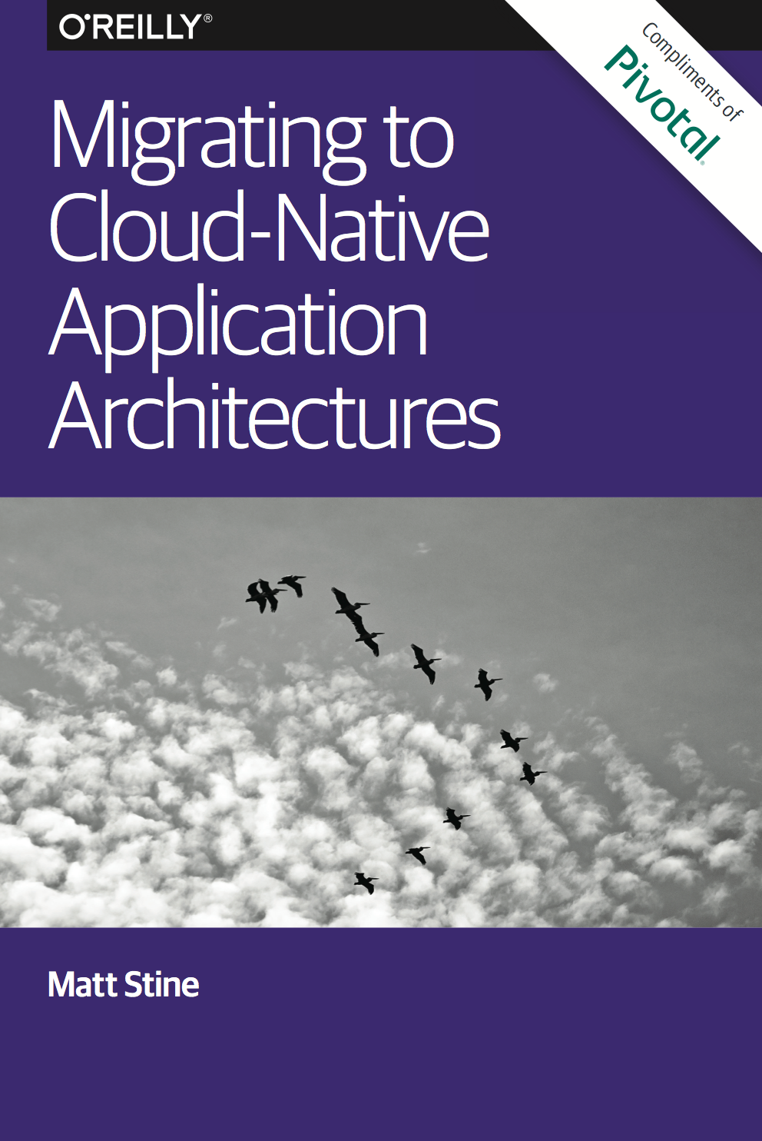
Looking to incubate a cloud native application model?
Application Framework
+
Platform Runtime
+
Infrastructure Automation
Complementary O’Reilly Book
http://bit.ly/cloud-native-book
Notes:
Looking to invest in cloud native applications? We wrote the book on it

Slide 4
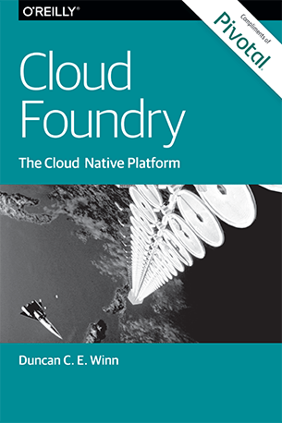
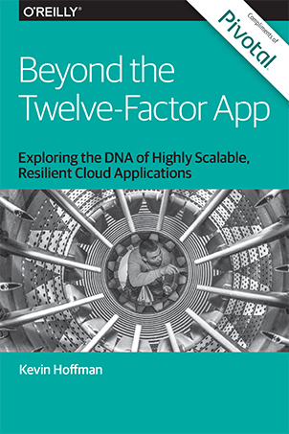
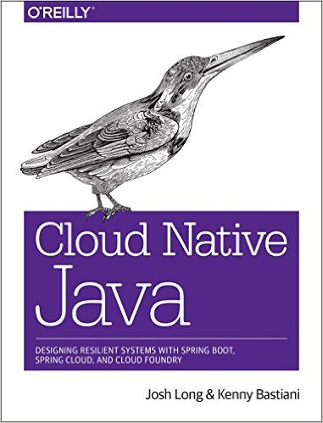
Read
By Duncan Winn (@duncwinn)
By Kevin Hoffman (@KevinHoffman)
By Josh Long (@starbuxman)
and Kenny Bastani (@kennybastani)

Slide 5
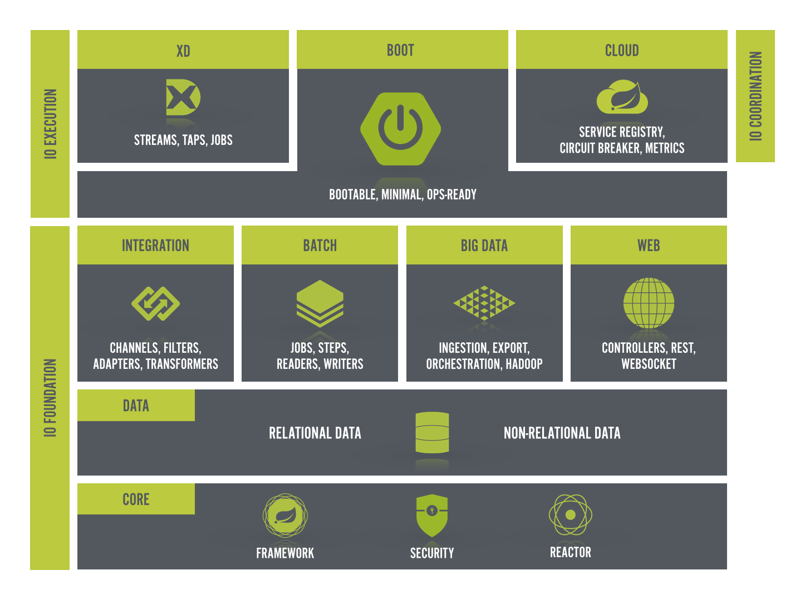
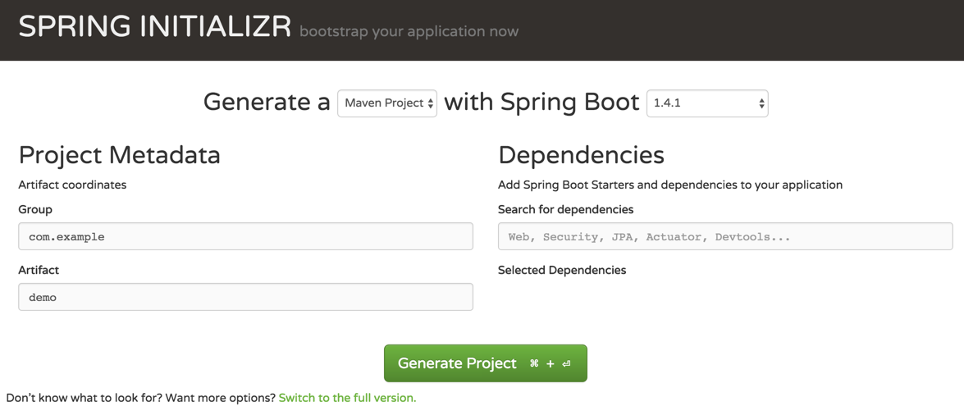
Build apps quickly with Spring Starter
http://start.spring.io

Slide 6
Resources
Pivotal home – http://pivotal.io
Pivotal Cloud Foundry Platform – http://pivotal.io/platform
Pivotal eBooks – http://pivotal.io/ebooks
Migrating to Cloud-Native Application Architectures - http://goo.gl/i0wwV8
The Cloud Native Journey, by Duncan Winn - http://goo.gl/Z3XLm7
Leading Enterprise Platform powered by Cloud Foundry - http://goo.gl/XfMp8h
The Cloud Native Journey Webinar Series - http://goo.gl/BOkxxj
Customer stories - https://www.youtube.com/watch?v=5q-ntJOKYA4
Ford’s FordPass - http://goo.gl/mDFBwO

Slide 7
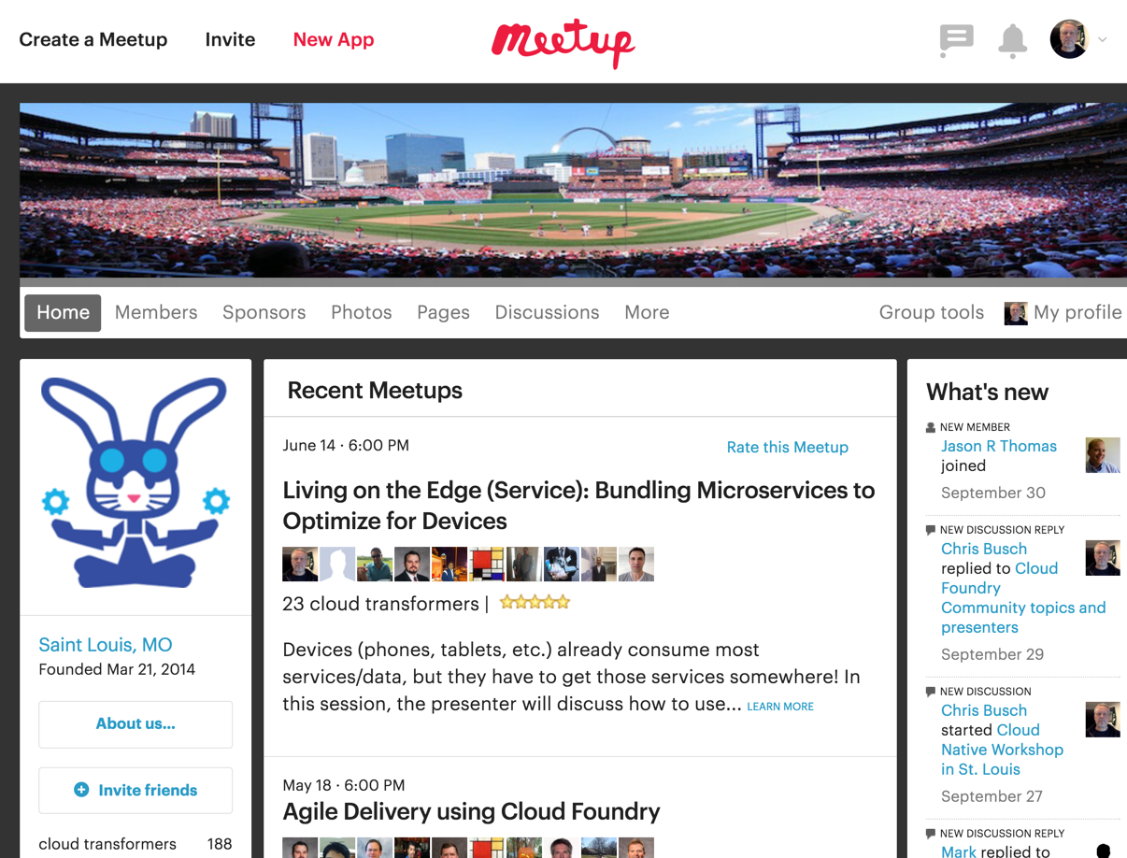
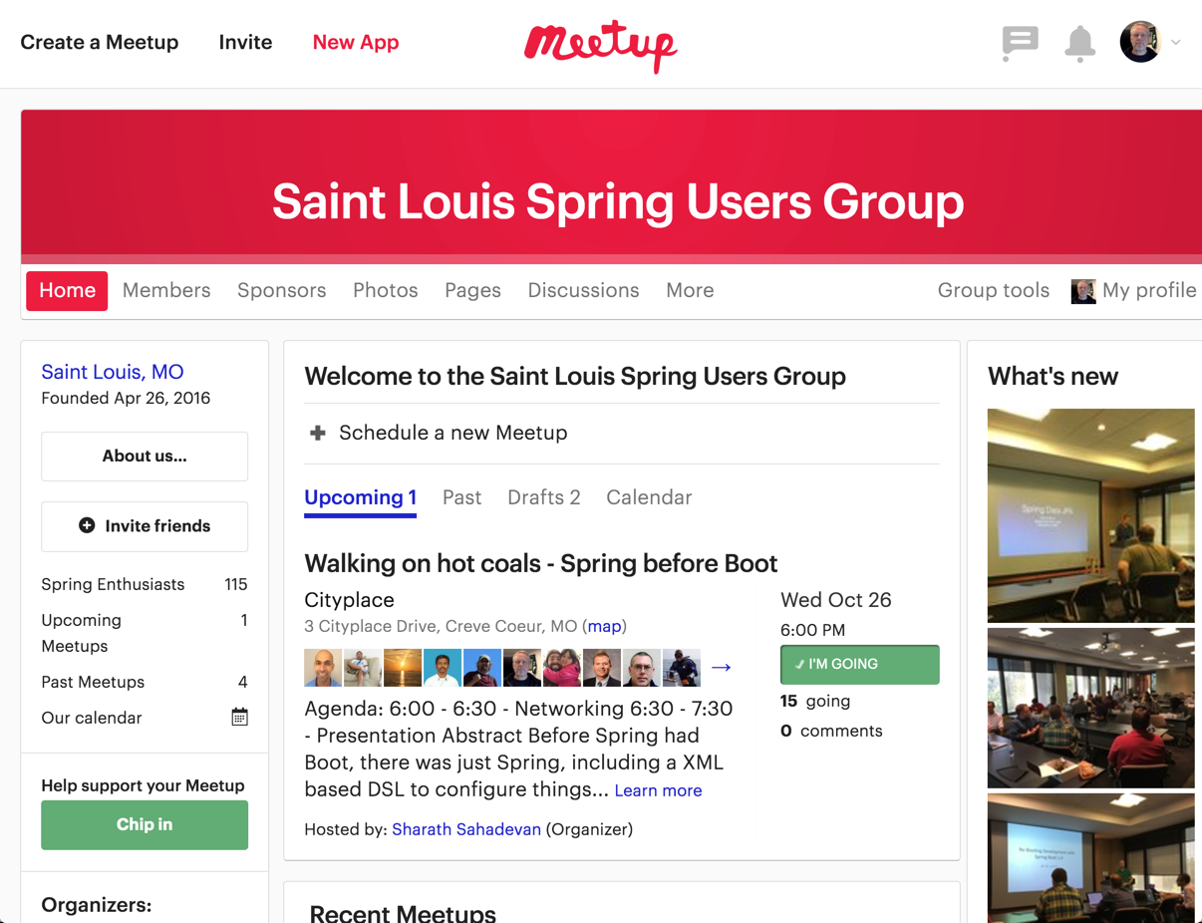
http://www.meetup.com/Saint-Louis-Cloud-Foundry-Meetup/
https://www.meetup.com/Saint-Louis-Spring-Meetup/

Slide 8
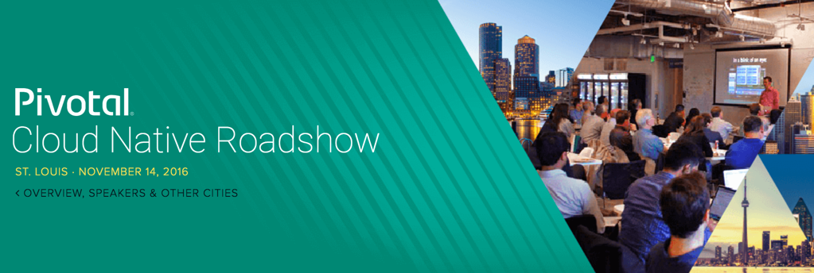
Speakers: Andrew Clay Shafer, Casey West, and Kenny Bastani
Pivotal will share how culture and technology integrate to reinforce each other, using modern tools and processes to build Microservices, promote DevOps, and facilitate Continuous Delivery.
https://pivotal.io/event/pivotal-cloud-native-roadshow/stlouis

Slide 9
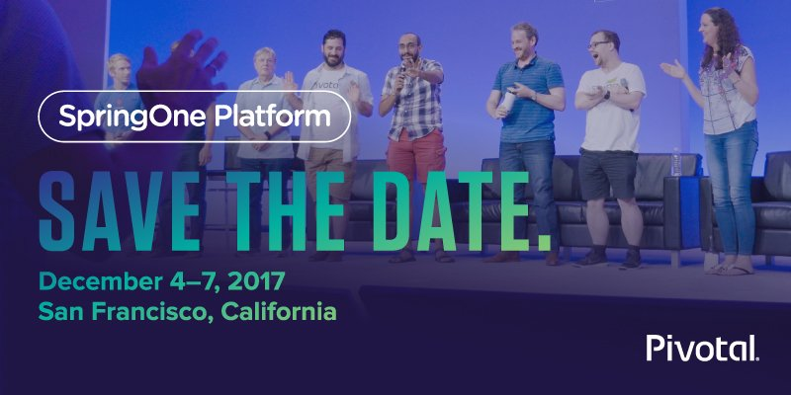
https://springoneplatform.io/

Slide 10

Q&A
Please complete the online workshop survey
https://goo.gl/forms/aD5y2Rlhn99CZUaA2
Notes:
AllState SVP Andy Zitney spoke at Summit on how Cloud Foundry brings their application development timelines from “100 days down to minutes”
Now I’d love to open this up for discussion.

Slide 11

THANK YOU!
Let’s build something MEANINGFUL

Slide 13
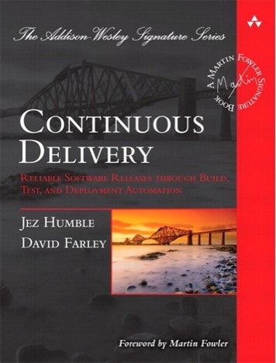
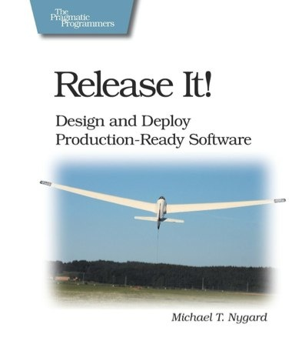
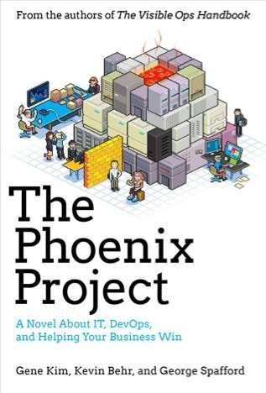
Foundations
Notes:
continuous integration of development changes
one package / many deploys
automation
deploy smaller batches more frequently
automate all testing where test failures would prevent prod release

Slide 14
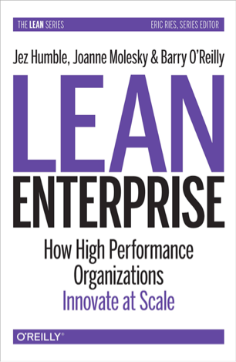
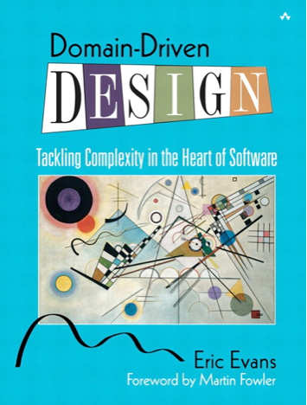
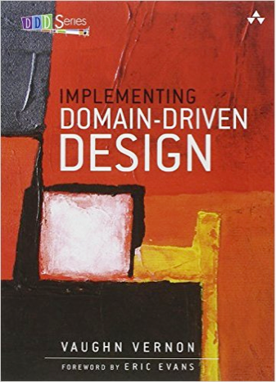
Foundations
Notes:
continuous integration of development changes
one package / many deploys
automation
deploy smaller batches more frequently
automate all testing where test failures would prevent prod release

